Slide 1
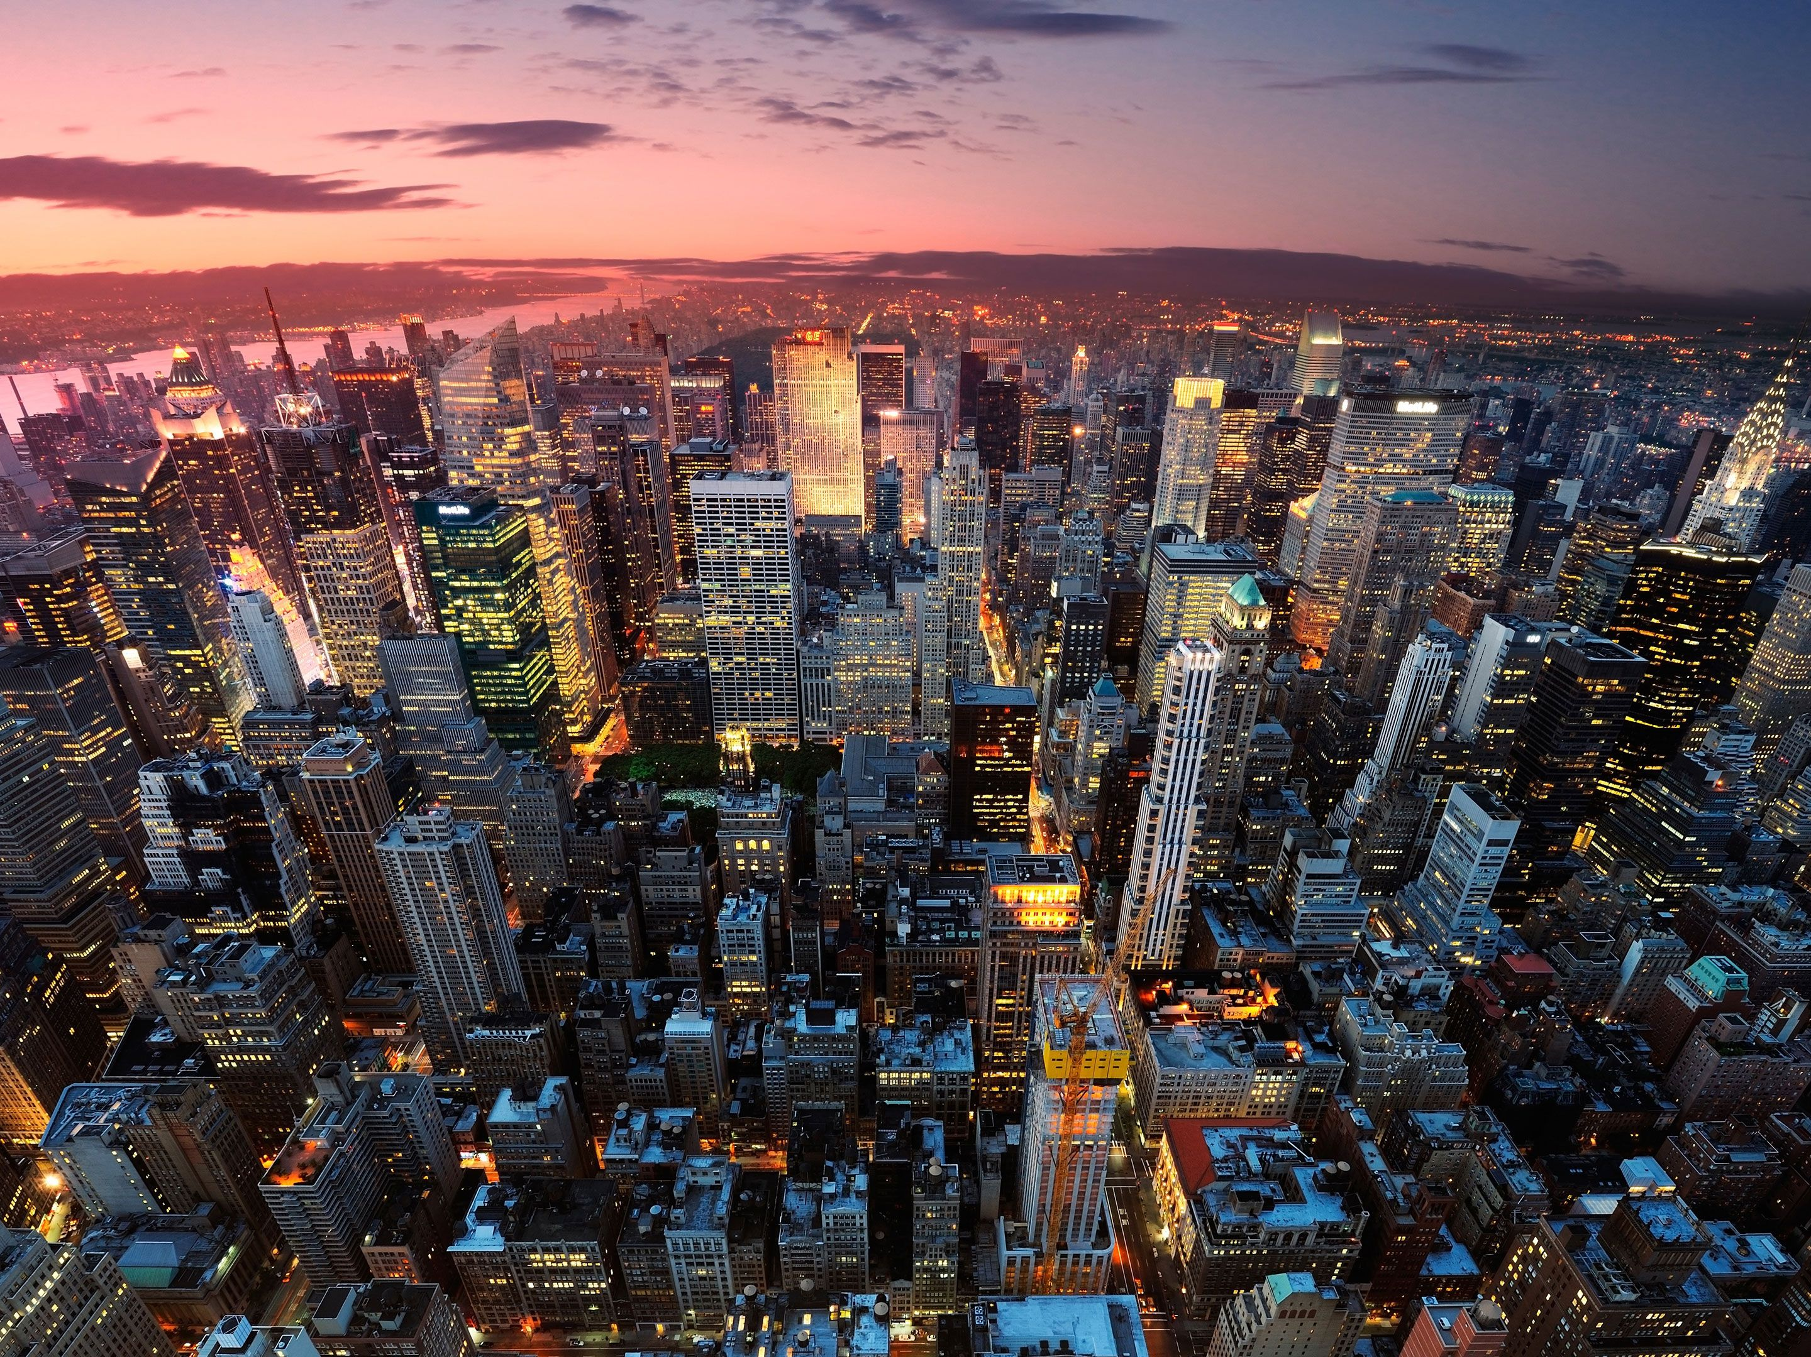
atAR GEOGRAPHY 4.1
Kimberly Wade-Wear #19956736

Slide 2
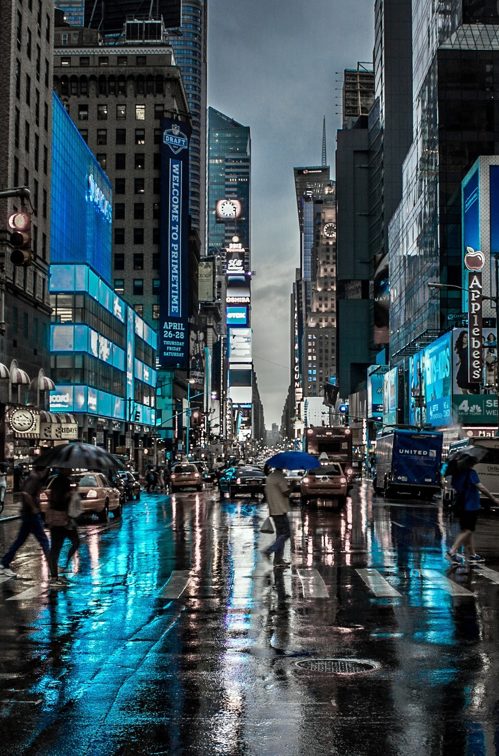
Syllabus points
the process of urbanisation
the processes of urban sprawl, invasion and succession, renewal, planning, land use competition, inertia and agglomeration

Slide 3

Urbanisation
Urbanisation refers to the overall increase in the proportion or urban dwellers in a region compared to the percentage of rural dwellers in that region over time. This is often linked to a population movement of people as they leave rural areas and relocate to urban areas due to various push-pull factors.
This trend is evident in India where 11.4% of the population lived in urban areas in 1901, had increased to 28.53% by 2001 and further increased to 31.16% by 2011.
There does not necessarily have to be a decline in rural population numbers but simply the overall proportion of urban dwellers has to increase over time.

Slide 4
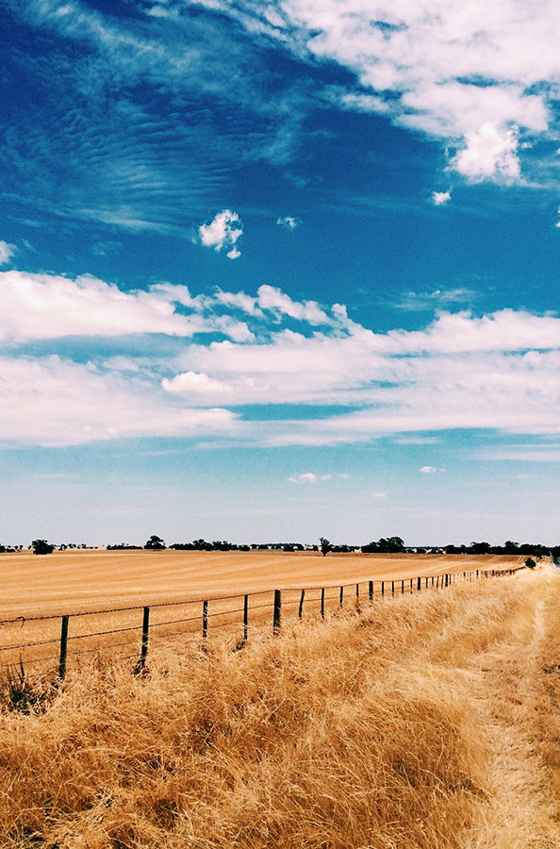
Urban Growth
Refers to the increase in the number of people living in an urban area over time.
Between 1960 and 2016 the urban population of the world increased from 1.01 billion to 4.03 billion.

Slide 5
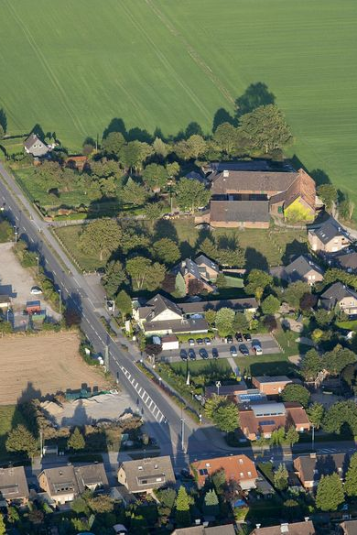
Urban Sprawl
Urban sprawl is the low density outward spread of a city mostly through the growth of largely unplanned housing developments. This is seen where newer growth zones continue to expand into the rural urban fringe to take up land once occupied by natural bushland or agriculture. Urban Sprawl can be seen in Perth in suburbs like Banksia Grove, Aveley, Byford and Alkimos.

Slide 6
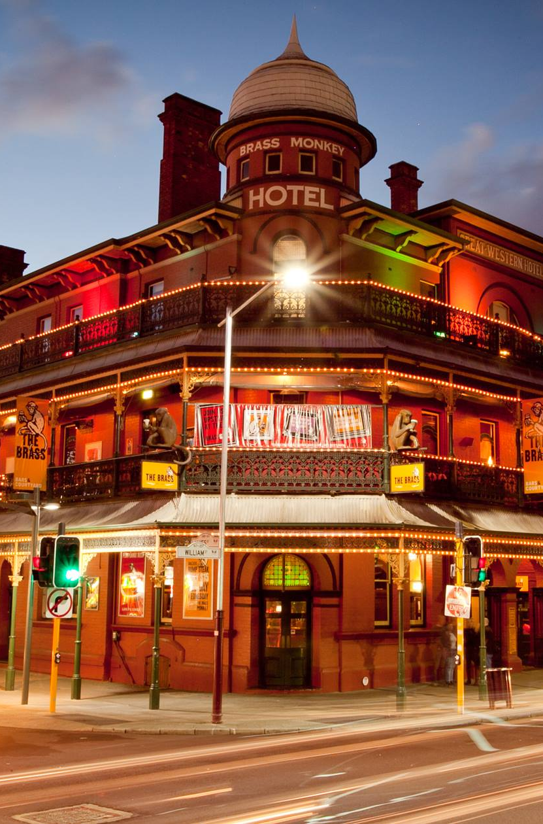
Invasion & Succession
Invasion refers to where a new land use (e.g business, commercial, retail) begins to move into an area once dominated by another land use (e.g residential). When this new invading land use begins to dominate this region then succession is said to have occurred.

Slide 7
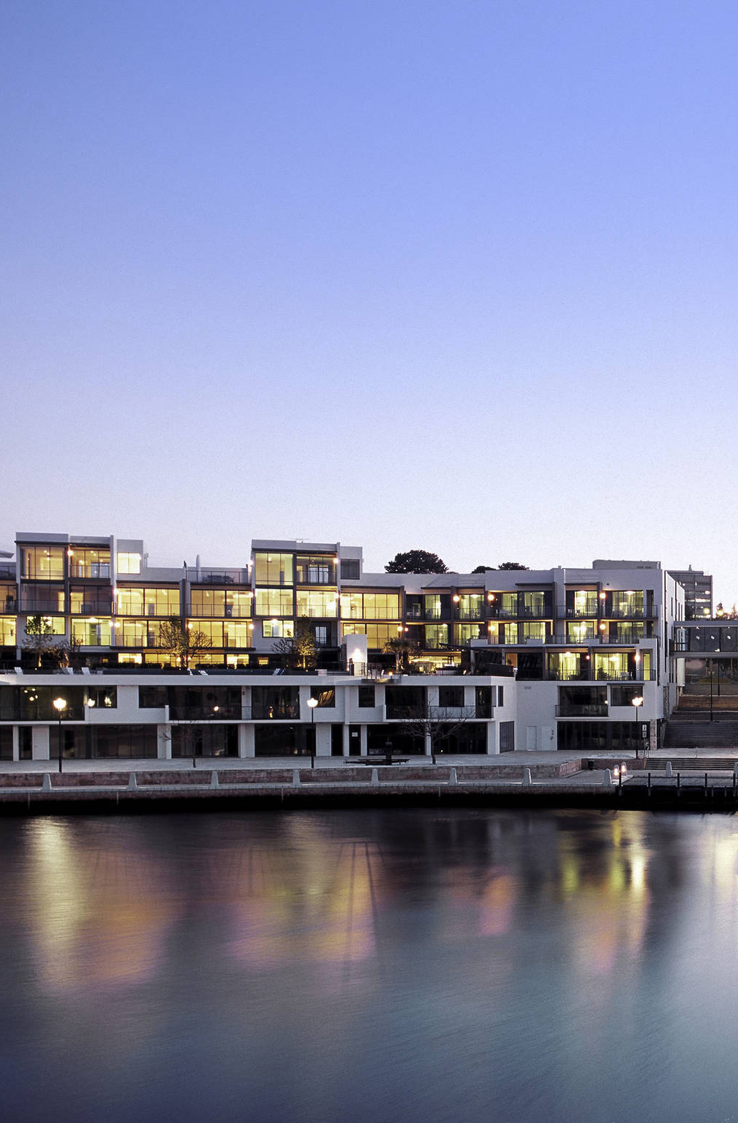
Urban renewal
Refers to the redevelopment of under-utilised and often, unattractive areas of a city to produce new residential and commercial opportunities, public space and supporting infrastructure that can highlight the benefits of land use change.
This is usually government initiated as was evident with the East Perth Redevelopment Program.

Slide 8
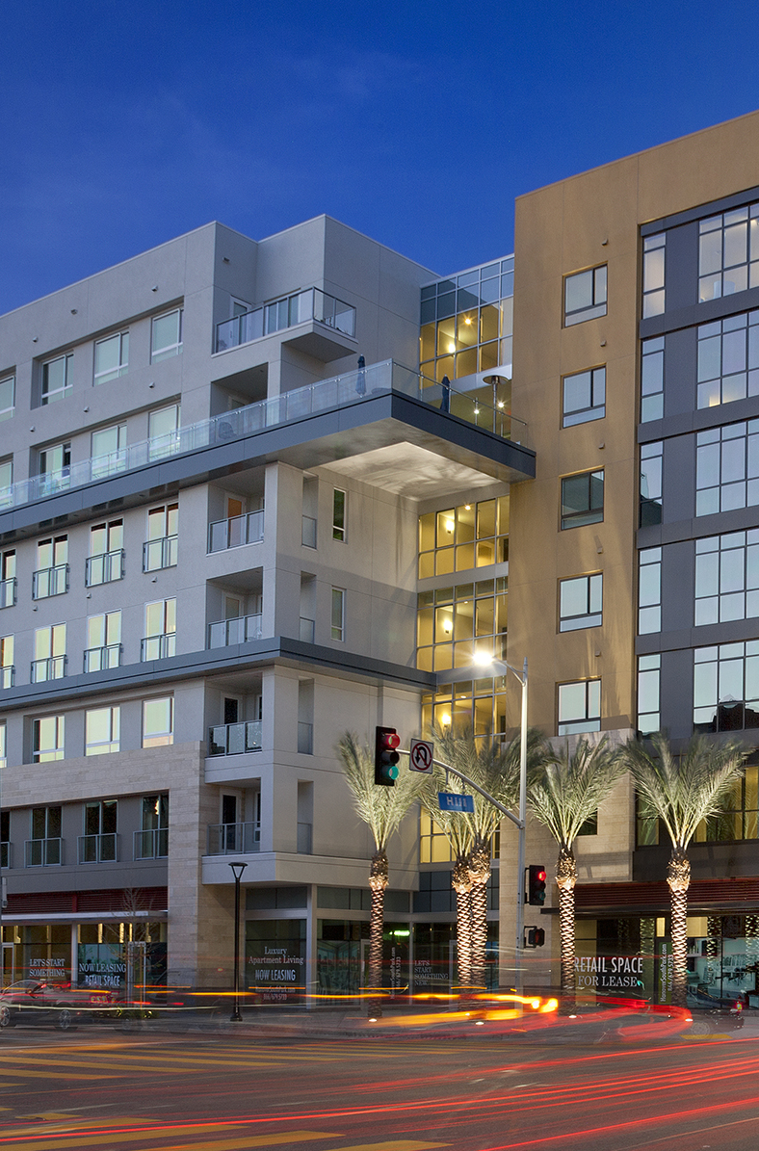
Land use competition
Is the sorting out process whereby those functions that have the ability to achieve the highest returns will locate where land values are the greatest. Since accessibility is the dominant force it results in competition for this land, thus forcing prices up. The city centre is the most desirable location and land values then tend to decrease with increasing distance from the city centre.

Slide 9
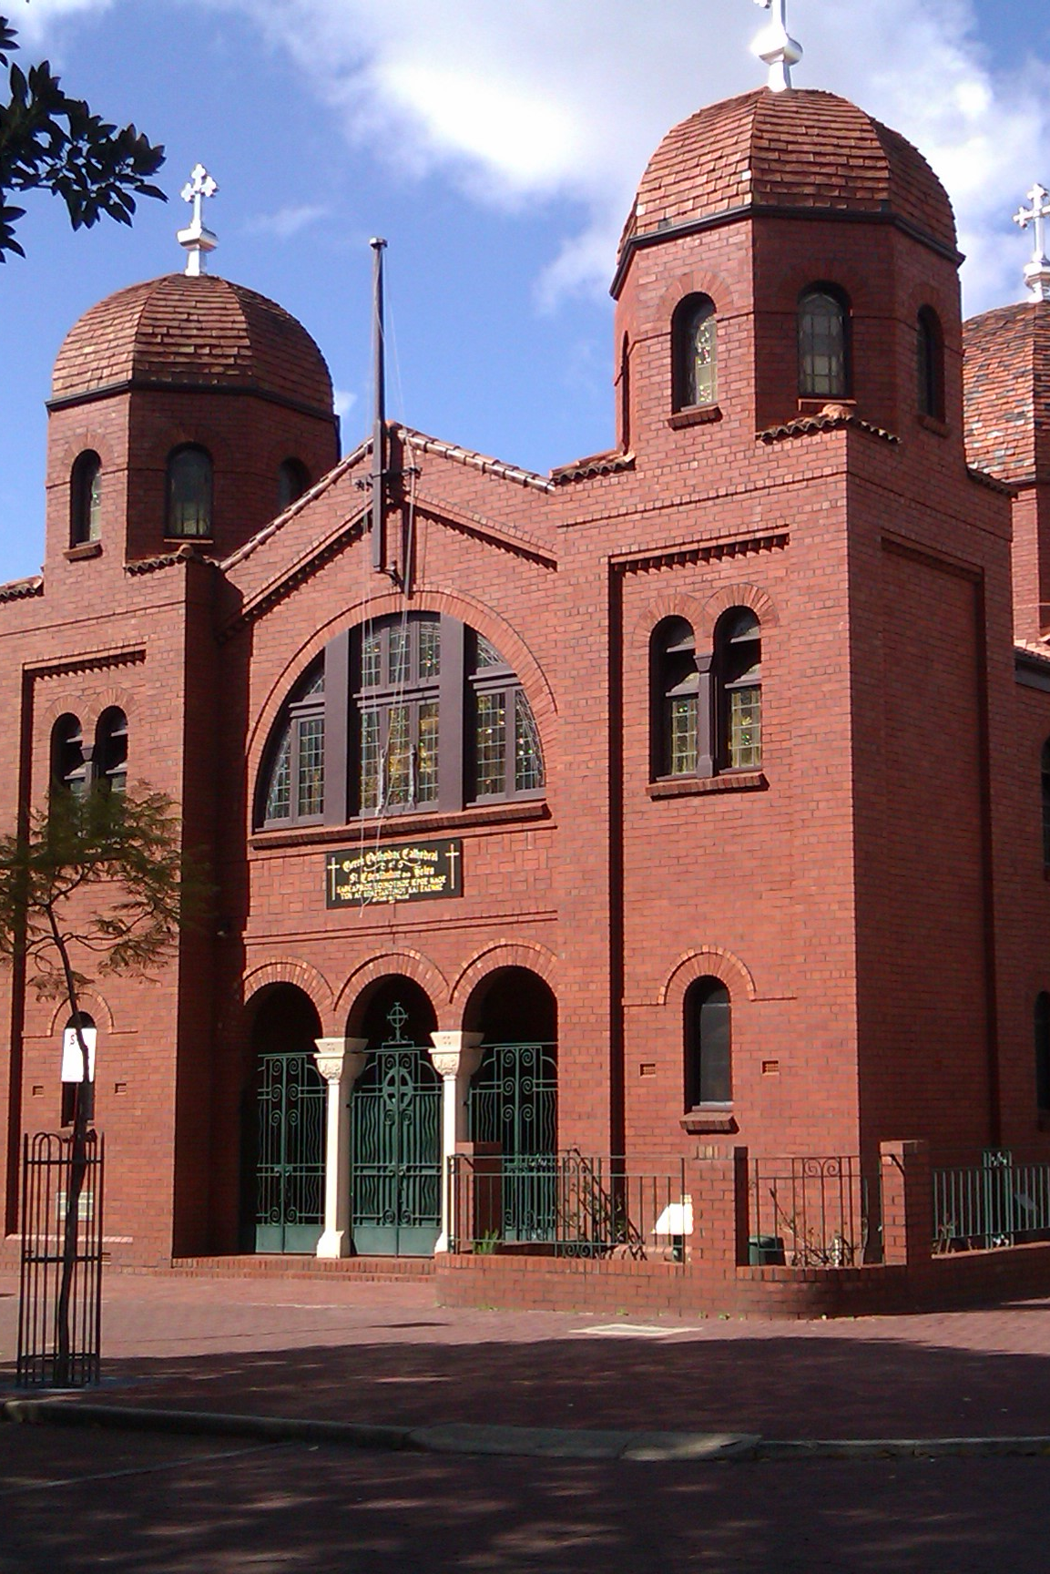
Inertia
The tendency for functions to resist change by remaining in their original location even though their initial reasons for location are no longer important. This process may produce a static land use pattern where there is very little change often caused by the high costs of relocation and the reluctance or lack of necessity to change.
The Greek Orthodox Church in Northbridge was once central to a Greek community that lived in close proximity.

Slide 10
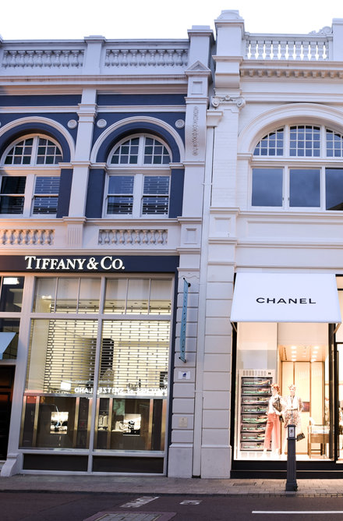
Agglomeration
Refers to an urban process that involves the grouping together of similar, but not necessarily the same, functions within a given location for mutual benefit. They cluster together due to the benefits of common infrastructure (e.g shared transport links). Industrial function commonly group together, such as the Kwinana industrial area in Perth.
King Street, Perth

Slide 11
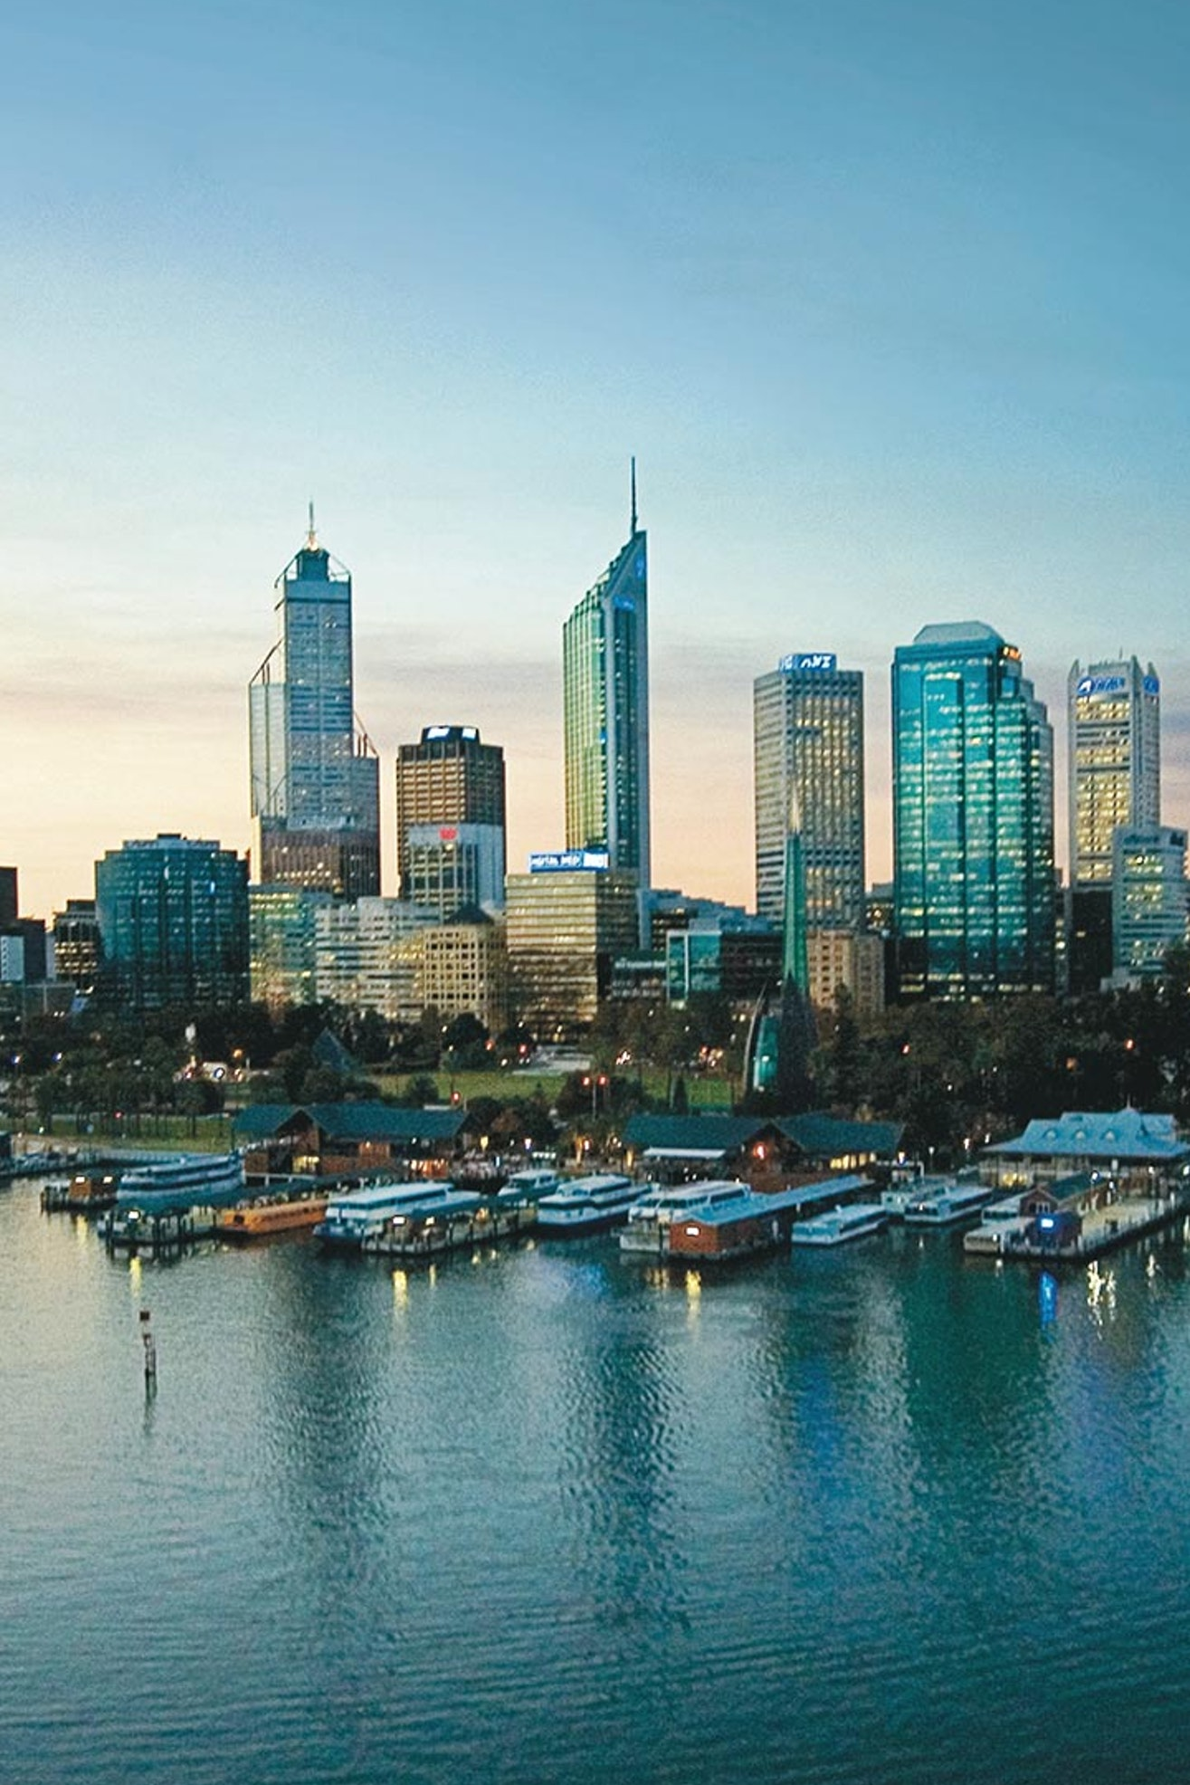
Planning
Refers to an urban process that determines what, when and how urban land uses are implemented. It attempts to group together compatible land uses, such as industry (e.g agglomeration), establish the separation of incompatible land uses and ensure there is a dispersed pattern of services throughout the urban area.
Directions 2031 and Beyond predict future population growth and distribute land use zones accordingly

